Slide 1

EVALUATE · TRAIN · BUILD
The Art of
Evaluating candidates
[ 30 MIN ]
Training interviewers
[ 30 MIN ]
Building the process
[ 30 MIN ]
Hiring
Notes:
Philosophy, content and process borrowed heavily from TellApart, Twitter, Wade Chambers, and "Who: The A Method for Hiring". Three arcs, about 30 minutes each.

Slide 2

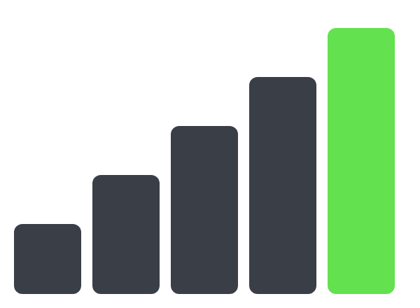
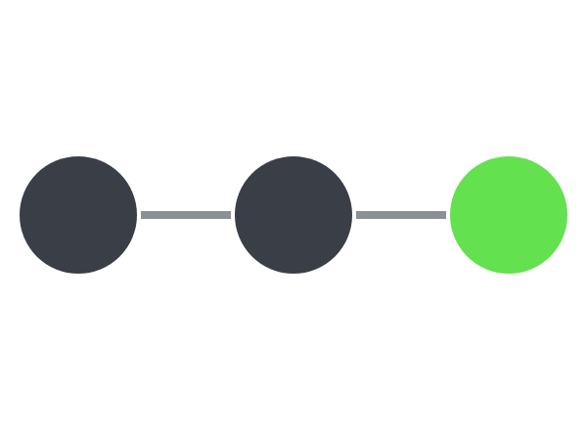
Three arcs.
One team of A players.
[ THE WHOLE TALK ]
01 · EVALUATE
02 · TRAIN
03 · BUILD
Strength × Fit
Five levels
3-stage process
Who should we hire?
What makes an interviewer great?
How do we run it?
Copyright Dobromir Montauk, 2026
[ 2 ]
Notes:
The whole talk on one slide. Arc 1: how we evaluate candidates, on two axes: Strength and Fit. Arc 2: how we train interviewers, through five levels from Competence to Landing. Arc 3: how we build the process, in three stages: getting to the interview, the interview, the close. Philosophy, content and process borrowed heavily from TellApart, Twitter, Wade Chambers, and "Who: The A Method for Hiring".

Slide 3
Hiring is a sales funnel.
[ WHAT IS HIRING? ]
SOURCE
SCREEN
Every stage converts…
ONSITE
…or leaks.
OFFER
ACCEPT
Copyright Dobromir Montauk, 2026
[ 3 ]
Notes:
Hiring is a SALES FUNNEL. Explain the basic concept: source, screen, onsite, offer, accept. Every stage converts some candidates and loses others.

Slide 4
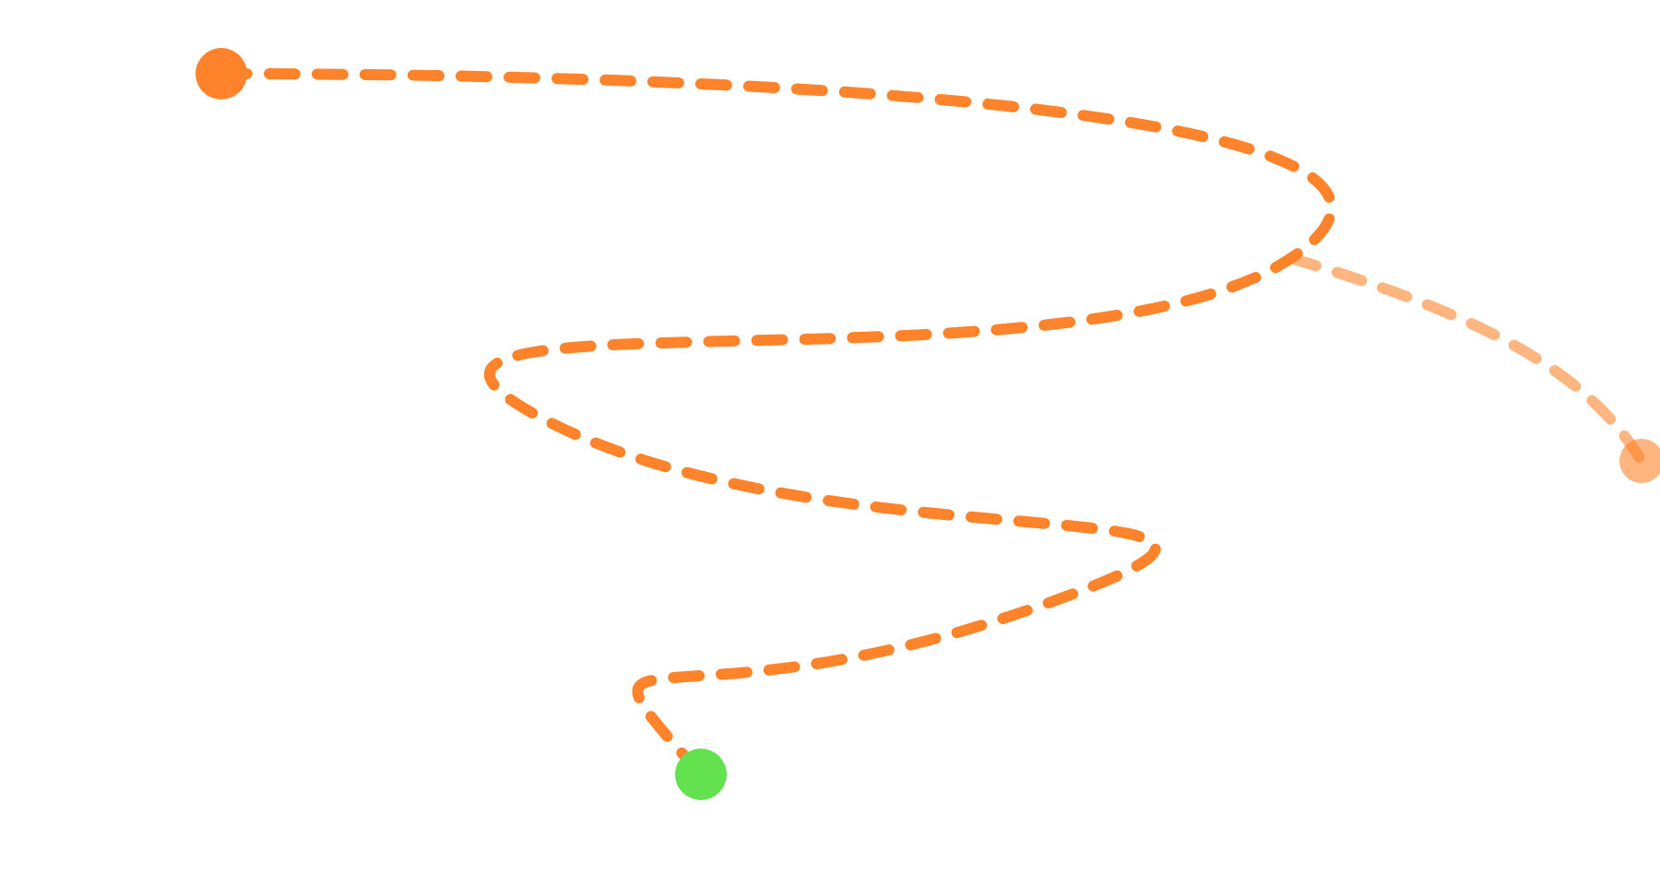
…but nobody moves through it in a line.
[ WHAT IS HIRING? ]
BOUNCE
SOURCE
Candidates skip ahead, stall for weeks, and drop out at every stage.
SCREEN
FALSE NEGATIVES / POSITIVES
ONSITE
Candidates might need to go backwards to avoid mishiring… or missing out on a great person.
OFFER
TIME IS A FRIENDLY FOE
Isn't it crazy that we make decisions that affect us for years after just a few hours with the team? We are all busy, so we optimize for less time here… often wrongly. Don't be afraid to increase time in each stage so a candidate feels valued, comfortable, and familiar with us.
ACCEPT
Copyright Dobromir Montauk, 2026
[ 4 ]
Notes:
But it's very messy. Sales funnels look linear, but people bounce around in them. False negatives and positives: candidates might need to go BACKWARDS to avoid mishiring, or missing out on a great person. Time is a friendly foe: isn't it crazy that we make decisions that affect us for years after just a few hours with the team? We are all busy, so we optimize for less time in this part, often wrongly so. Don't be afraid to INCREASE the amount of time in each stage to make a candidate feel valued, comfortable, familiar with us, etc.

Slide 5

Every part of the funnel is a different filter.
[ WHAT IS HIRING? ]
SOURCE
→ Are they on the market?
RECRUITER SCREEN
→ Would they ever even choose us?
EM SCREEN
→ Will they be excited about us?
TECH SCREEN
→ Are they likely to be a good engineer?
ONSITE
→ Are they a GREAT engineer?
→ Will they thrive at Mashgin?
OFFER
→ Will they choose US over the competition?
Copyright Dobromir Montauk, 2026
[ 5 ]
Notes:
Every part of the funnel is a different filter, and each person in the process needs to know which filter they are. Source: are they on the market? Recruiter screen: would they ever even choose us? EM screen: will they be excited about us? Technical screen: are they likely to be a good engineer? Onsite: are they a GREAT engineer, and will they thrive at Mashgin? Offer: will they choose US over the competition?

Slide 6
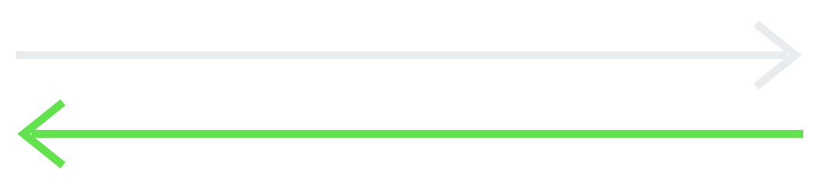
But it's also matchmaking!
Why would they choose US?
[ WHAT ELSE IS HIRING? ]
Us
Them
WE CHOOSE THEM
THEY CHOOSE US
Copyright Dobromir Montauk, 2026
[ 6 ]
Notes:
What else is hiring? Matchmaking. Dating. It runs both ways: we choose them, and they choose us. Why would they choose US?

Slide 7
How are they judging US?
[ THE OTHER DIRECTION ]
← Does Mashgin seem like an interesting company / problem / technology / team / whatever I care about…?
SOURCE
RECRUITER SCREEN
← Who are these people? What is their “culture”?
EM SCREEN
← Would I want to work for this person?
TECH SCREEN
← Are these engineers sharp?
ONSITE
← Will I learn from these people?
← Will I grow here?
OFFER
← Is this the best bet for my career?
Copyright Dobromir Montauk, 2026
[ 7 ]
Notes:
Same funnel, opposite direction. At every stage the candidate is running their own filter on us. Source: Does Mashgin seem like an interesting company / problem / technology / team / whatever I care about…? Recruiter screen: who are these people? What is their “culture”? EM screen: would I want to work for this person? Tech screen: are these engineers sharp? Onsite: will I learn from these people, will I grow here? Offer: is this the best bet for my career?

Slide 8
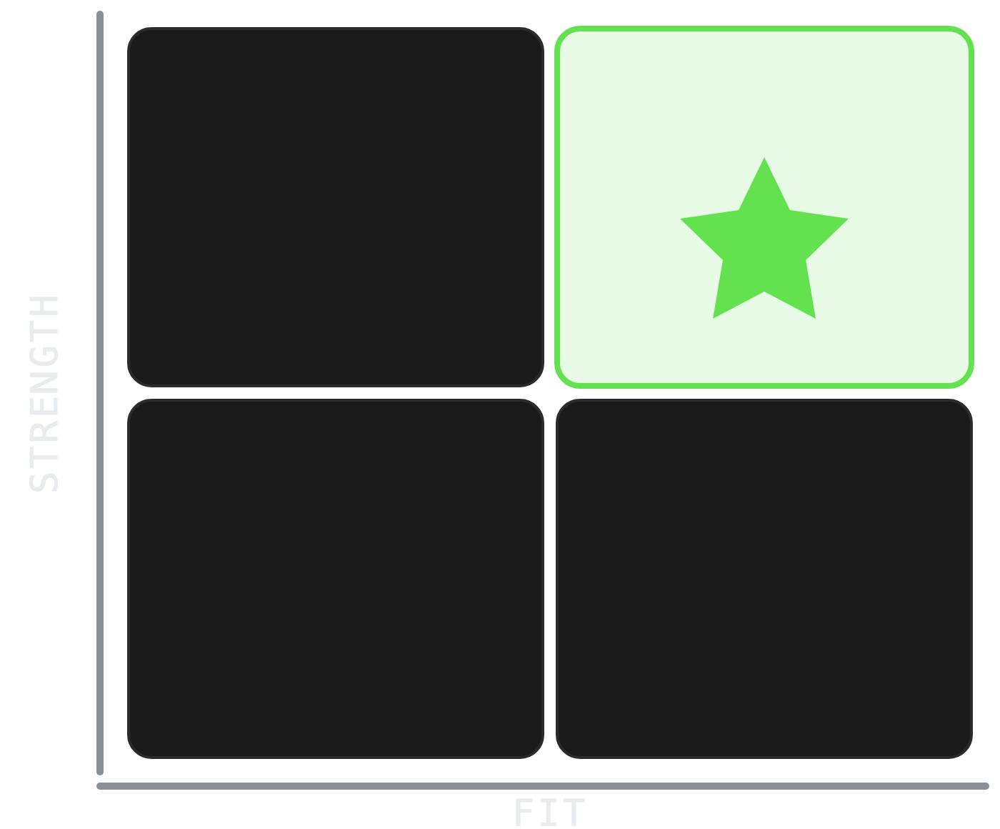
Strength × Fit
[ TWO DIMENSIONS ]
We want top-right candidates.
Candidates want top-right companies.
Neither side ever defines it. Both choose on “vibes.”
Copyright Dobromir Montauk, 2026
[ 8 ]
Notes:
Two dimensions: Strength and Fit. We want top-right candidates. Candidates want top-right companies. Both sides never define this, and choose on "vibes". The rest of this arc defines each axis.

Slide 9
Defining “Strength”: A, B, C, D players
[ STRENGTH ]
A
B
C
D
90% likely to solve the problems you throw at them.
75% likely to solve the problems you throw at them.
60% likely to FAIL. Why risk it?
Lowers team productivity, drives away key talent, degrades the codebase.
HOW THEY AFFECT OTHERS ↓
Attracts other A players.
Can irritate A players.
Drives away A players.
Gets you fired.
* Depends on the role → an A player in one role might be a D player in another!
Copyright Dobromir Montauk, 2026
[ 9 ]
Notes:
A player: 90% likely to solve the problems you throw at them; attracts other A players. B: 75% likely; can irritate A players. C: 60% likely to FAIL, so why risk it? Drives away A players. D: lowers team productivity, drives away key talent, degrades the codebase; gets you fired. The "affect others" row is from the Who book: A players attract A players, B players irritate them, C players drive them away, D players get you fired for reducing productivity, driving away key talent, and reducing codebase quality.

Slide 10
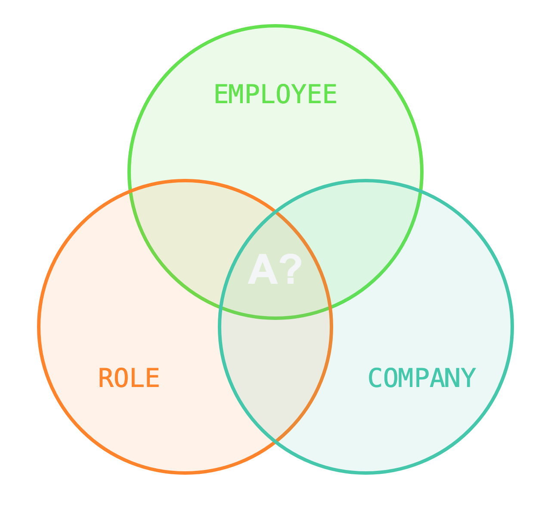
Would they be an A player here?
[ FIT RUNS THREE WAYS ]
EMPLOYEE
Skill / Will “vector”
ROLE
Too big
Too small
Not interesting
“Goldilocks problem”
COMPANY
Culture: “the unspoken rules”
Copyright Dobromir Montauk, 2026
[ 10 ]
Notes:
Fit runs three ways: employee, company, role. Employee perspective: what will I learn? What can I teach? What value can I add? How will this advance my career? Do I like the culture, the product, the team? Company perspective: is there a 90% chance they can do what only the top 10% can do in the role? Do they fit culturally? Do they exhibit the company's key values? What is the value, what is the risk?

Slide 11


Anyone can get lucky.
A players bat with consistency.
[ WHAT IS AN A PLAYER? ]
A PLAYER
9 / 10
GOT LUCKY
1 / 10
Look for a track record of winning, not just one home run.
Copyright Dobromir Montauk, 2026
[ 11 ]
Notes:
Imagine 100 similarly difficult problems given to 100 different people. Pick the 10% with the best solutions: that's the bar. "90% chance of achieving outcomes" guarantees consistency instead of randomness. Someone might come up with a great solution to one of those 100 problems. Can they do it 9 times out of 10, across the other problems? If not, they just got lucky. So look for a track record of winning, not just one home run.

Slide 12
Defining “Fit”: −10 to +10
[ FIT ]
−10 · UNALIGNED
0
+10 · ALIGNED
Mercenary
Ambivalent
Missionary
Here for what they can extract.
Could go either way.
Wants what we want.
Do they want what we need, and do we offer what they want? Both directions.
Copyright Dobromir Montauk, 2026
[ 12 ]
Notes:
Strength is one axis; Fit is the other. Fit runs from −10 (unaligned, mercenary) through 0 (ambivalent) to +10 (aligned, missionary). It's about alignment in both directions: do they want what we need, and do we offer what they want? The next slides explain why fit matters so much for us, and what it sounds like.

Slide 13
Mercenary
[ FIT · −10 ]
fixed mindset
defending
me
extrinsics
activity
similar
logarithmic growth
participant
apathetic
potential
victim
job
watch
debate
IN ENGINEERS
résumé-driven development
title-chaser
counting to the vesting cliff
comp before the problem
“not my job”
ticket-taker
AT MASHGIN
cargo-culting
offer-shopping
hotness-chaser
VIBE CHECK: “Pay me.”
Copyright Dobromir Montauk, 2026
[ 13 ]
Notes:
Mercenary. "Pay me." Fixed mindset, defending, me, extrinsics, activity over impact, participant, apathetic, victim. It's a job. In engineers: résumé-driven development (picking tech because it looks good on a CV, not because it fits the problem), chasing titles, counting down to the vesting cliff, asking about comp before the problem, "not my job", taking tickets instead of owning outcomes. At Mashgin: cargo-culting, offer-shopping, hotness-chasing.

Slide 14
Missionary
[ FIT · +10 ]
growth mindset
learning
we
intrinsics
impact
diverse
exponential growth
owner
empathetic
accomplished
determined
career
engage
AT MASHGIN · ASK THE ROOM
?
?
?
?
?
VIBE CHECK: “Grow me.”
Copyright Dobromir Montauk, 2026
[ 14 ]
Notes:
Missionary. "Grow me." Growth mindset, learning, we, intrinsics, impact, owner, empathetic, determined, career. Then ask the room: what does a MASHGIN missionary look like? Collect their answers before revealing the next slide.

Slide 15
Missionary
[ FIT · +10 AT MASHGIN ]
growth mindset
learning
we
intrinsics
impact
diverse
exponential growth
owner
empathetic
accomplished
determined
career
engage
AT MASHGIN
scrappy
loves hardware
efficiency
first principles
build, don't buy
VIBE CHECK: “Grow me.”
Copyright Dobromir Montauk, 2026
[ 15 ]
Notes:
Reveal: the Mashgin missionary attributes. Scrappy? Loves hardware. Efficiency. First principles. Build, don't buy. Compare with what the room said.

Slide 16
Why is fit SO important — at a STARTUP?
[ WHY FIT? ]
RISK
CONVERSION
MASLOW MOTIVATION
Lots of teams. Can switch if needed.
OK being a small part of something BIG.
Wants $ / Esteem
BIG TECH
Must fit on THIS team, otherwise fired.
Wants to be the HERO in their thing.
Seeking Self-Actualization
MASHGIN
Copyright Dobromir Montauk, 2026
[ 16 ]
Notes:
Why is fit SO important for us? Risk: at Google there are lots of teams, so someone can switch if it doesn't work out. At Mashgin they must fit on THIS team, otherwise they get fired. Conversion: at Google people are OK being a small part of something BIG. At Mashgin they want to be the HERO in their thing. (That difference is what converts a candidate.) Maslow motivation: Big Tech candidates want $ / esteem; Mashgin candidates are seeking self-actualization. When I joined TellApart and learned they evaluated candidates on FIT, not just technical skill, I was surprised: Google didn't, and it worked fine for them. It took time to realize Google != TellApart. Candidates can feel fit too: they often choose a company where they are a unique fit that unlocks their needs. People want to be heroes. That's the main lever startups can pull better than big companies.

Slide 17

Strength × Fit
[ SHOULD YOU HIRE THEM? ]
Mercenary
Confused?
Rock Star
can be acclimated
Unicorn
hire at all costs
A
Consultant
Ambivalence
Ambivalence
Team Player
hire at all costs
B
Hell No!!!
Hell No
No
No
C
Will get you fired
Will get you fired
Will get you fired
Will get you fired
D
−10 UNALIGNED
FIT →
+10 ALIGNED
Copyright Dobromir Montauk, 2026
[ 17 ]
Notes:
Put the two axes together. A and B players who are aligned: hire at all costs (Unicorn, Team Player). Strong but unaligned: Mercenary or Consultant. C and D players: no, whatever the fit. D players will get you fired.

Slide 18
The area of confusion.
[ SHOULD YOU HIRE THEM? ]
Mercenary
Confused?
Rock Star
can be acclimated
Unicorn
hire at all costs
A
Consultant
Ambivalence
Ambivalence
Team Player
hire at all costs
B
Hell No!!!
Hell No
No
No
C
Will get you fired
Will get you fired
Will get you fired
Will get you fired
D
−10 UNALIGNED
FIT →
+10 ALIGNED
Copyright Dobromir Montauk, 2026
[ 18 ]
Notes:
The middle of the fit axis is where most of the hard calls live: Confused, Ambivalent, the Rock Star who can be acclimated. This is where interviewers disagree.

Slide 19
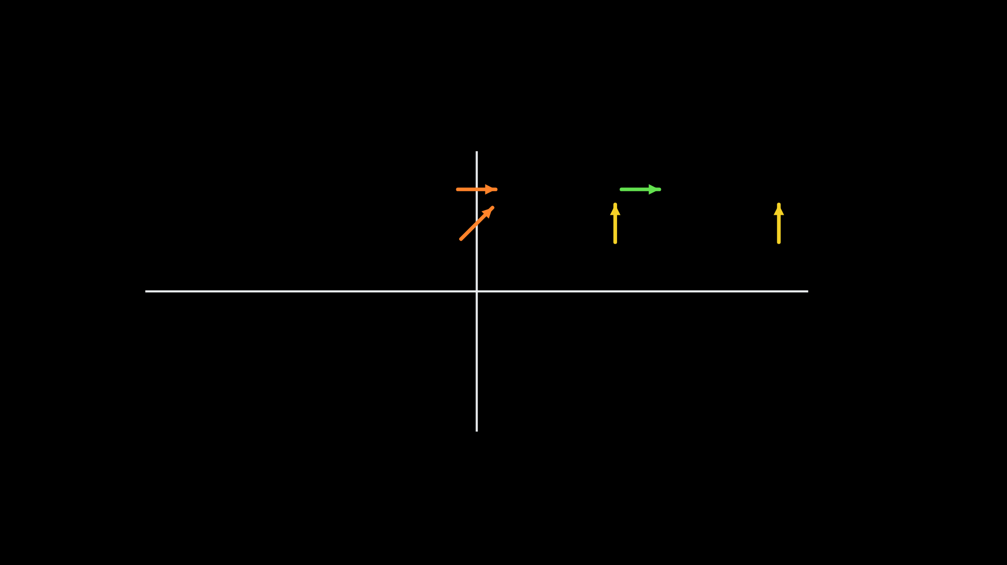



Resolve it, or coach it.
[ SHOULD YOU HIRE THEM? ]
Mercenary
Confused?
Rock Star
can be acclimated
Unicorn
hire at all costs
A
Resolve before hiring
Consultant
Ambivalence
Ambivalence
Team Player
hire at all costs
Coach in the first 90–180 days
B
Hell No!!!
Hell No
No
No
Coach in the first 2 years
C
Will get you fired
Will get you fired
Will get you fired
Will get you fired
D
−10 UNALIGNED
FIT →
+10 ALIGNED
Copyright Dobromir Montauk, 2026
[ 19 ]
Notes:
Confusion and ambivalence: resolve before you hire (red arrows). Moving up a strength level, B to A: you can coach that in the first 90-180 days (yellow). A Rock Star becoming a Unicorn, fully aligned: you can coach that over the first 2 years (green). 90-day reviews let you cut the B players if you made a mistake. Hold yourself accountable to coaching them.

Slide 20



Give them some pain.
[ RESOLVE BEFORE HIRING: MERCENARIES ]
CHALLENGE
MAKE IT REAL
COLD SPLASH
World View
Lower Pay
Title Shrink
How they react tells you how they think about the role. (You can always walk it back later.)
Copyright Dobromir Montauk, 2026
[ 20 ]
Notes:
Tools to identify MERCENARIES/CONSULTANTS: give them some pain they won't accept. Challenge their world view. Make it real: lower pay. Cold splash: title shrink. How they react will tell you a lot about how they are thinking about the role. You can always walk it back later.

Slide 21



Was it THEM, or their environment?
[ RESOLVE BEFORE HIRING: B PLAYERS ]
RE-INTERVIEW
LACKED OPPORTUNITY
WRONG MENTORSHIP
Missed Strengths
Challenging Onboarding
Pair with Your Best
A B on paper can be opportunity and coaching, not ability.
Copyright Dobromir Montauk, 2026
[ 21 ]
Notes:
Before writing someone off as a B player, check whether it was them or their environment. Interview process failure: we didn't find their strengths, so re-interview for the strengths we missed. Lacked opportunity: give them a challenging onboarding. Wrong mentorship: pair them with your best. Some of our Mashgin Brazil team were B players because of OPPORTUNITY and PREVIOUS COACHING.

Slide 22
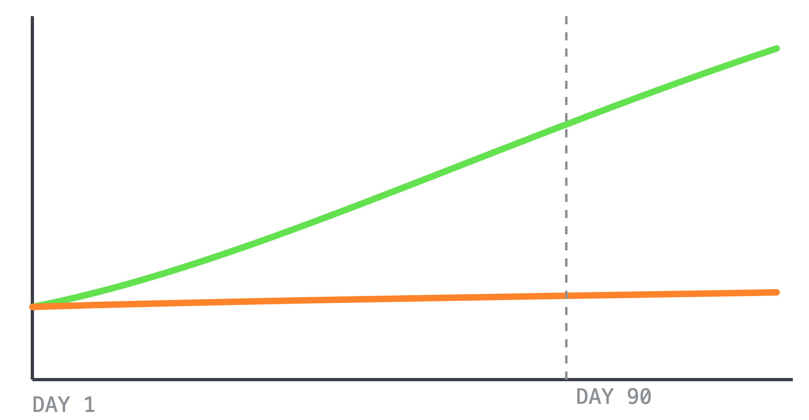
Grit + intelligence: watch the slope.
[ RESOLVE BEFORE HIRING: B PLAYERS ]
A PLAYER
Adjusts fast.
B PLAYER
Never pushed themselves. No change by day 90.
Copyright Dobromir Montauk, 2026
[ 22 ]
Notes:
Tools to identify B players (grit + intelligence): they never pushed themselves before, and in 90 days they don't adjust their behavior.

Slide 23
[ SO HOW DO WE RUN IT? ]
Candidates see the process.
But they judge the culture.
Copyright Dobromir Montauk, 2026
[ 23 ]
Notes:
Candidates see the process, but they judge the culture. Who we are in the interview process should reflect our core values. The candidate is evaluating us the whole time. Three things they see.

Slide 24



Startup vibes.
[ THE PROCESS IS OUR CULTURE · 1 ]
MOVE SLOW, THEN FAST
MISSIONARY ZEEL
NO PRESSURE SELLING
“Where are you in YOUR process?”
“What do you need to commit?”
“This is an important decision for you — and us. Take the weekend and let us know Monday.”
Copyright Dobromir Montauk, 2026
[ 24 ]
Notes:
Speed matters. We lose candidates when we move slowly. One candidate never even got to the onsite. Another was held back for weeks, then took a competing offer. We can control our speed. How do we create a sense of urgency on the candidate side? If we succeed, we can control their speed to some degree too. We never want to lie ("I only have 2 roles open"). Move slow, then fast: we lose if they think about it for months; schedule onsites when they are ready to decide. Missionary zeal: we expect people to make quick decisions on incomplete information, and that includes the interview. No pressure selling: we don't take important decisions lightly; give people the space to think and decide, without any fake urgency.

Slide 25
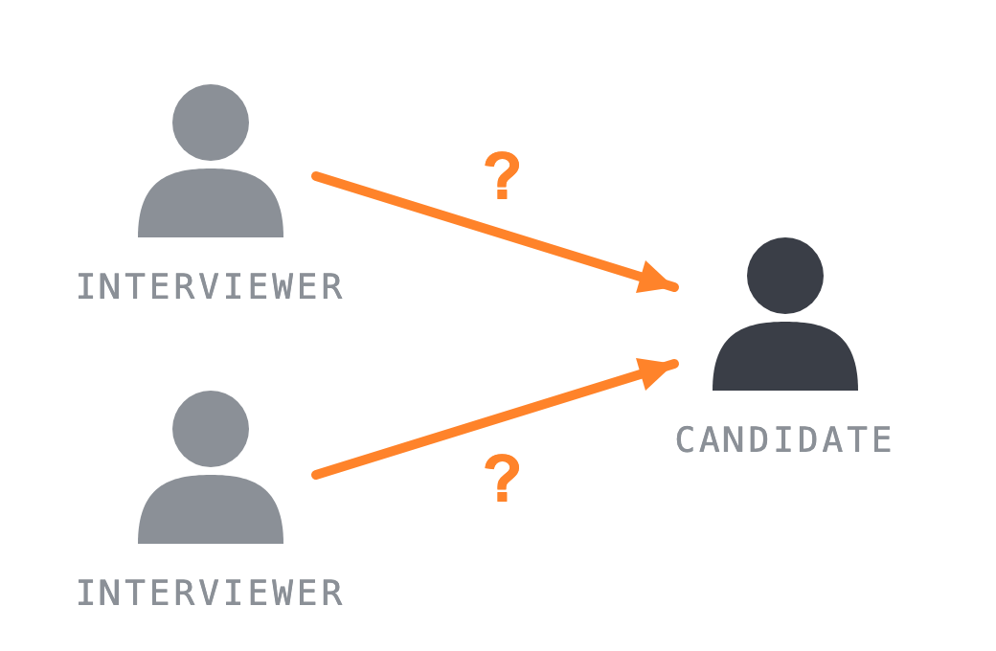
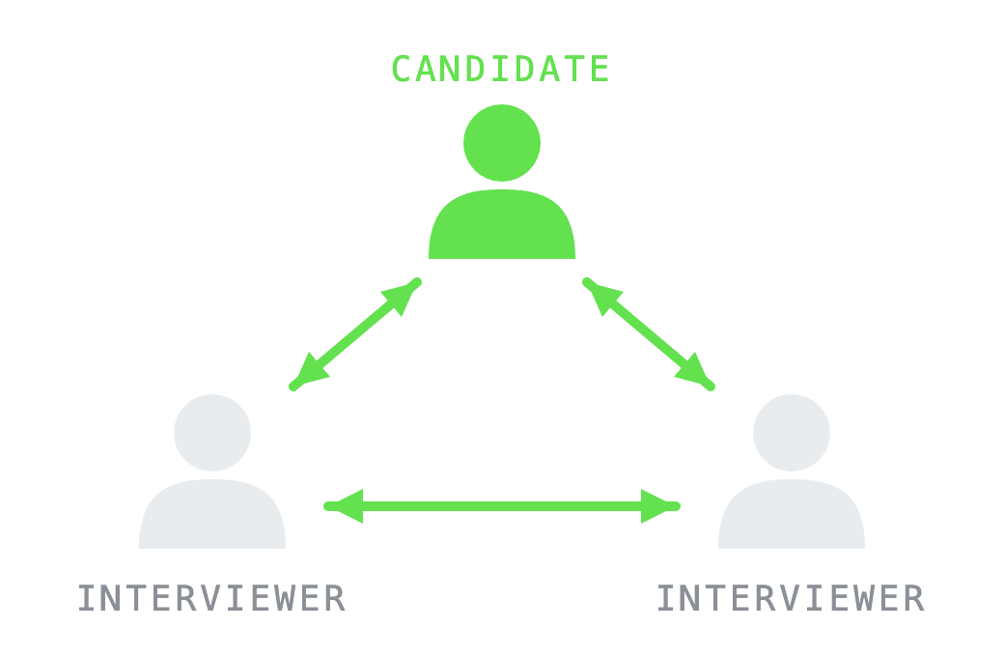
Two people.
A conversation, not a grilling.
[ THE PROCESS IS OUR CULTURE · 2 ]
GRILLING
CONVERSATION
Questions fired one way.
Ideas flow every direction.
Copyright Dobromir Montauk, 2026
[ 25 ]
Notes:
Every interview has two interviewers in the room. The dynamic should be a conversation between three people, not two people grilling one.

Slide 26
A growth factory, from the first call.
[ THE PROCESS IS OUR CULTURE · 3 ]
01 · FIRST CALL
Recruiter
“Where do you want to grow?”
02 · SCREEN
EM
“What's your next step?”
03 · ONSITE
Engineers
“Here's how you'd grow here.”
04 · TOPGRADING
EM
“Here is feedback on your performance.”
Every person they meet shows interest in their growth.
Copyright Dobromir Montauk, 2026
[ 26 ]
Notes:
From recruiters, to the EM, to the engineers: every touchpoint shows real interest in the candidate's growth. That's how they learn we're a growth factory before they ever join.

Slide 27
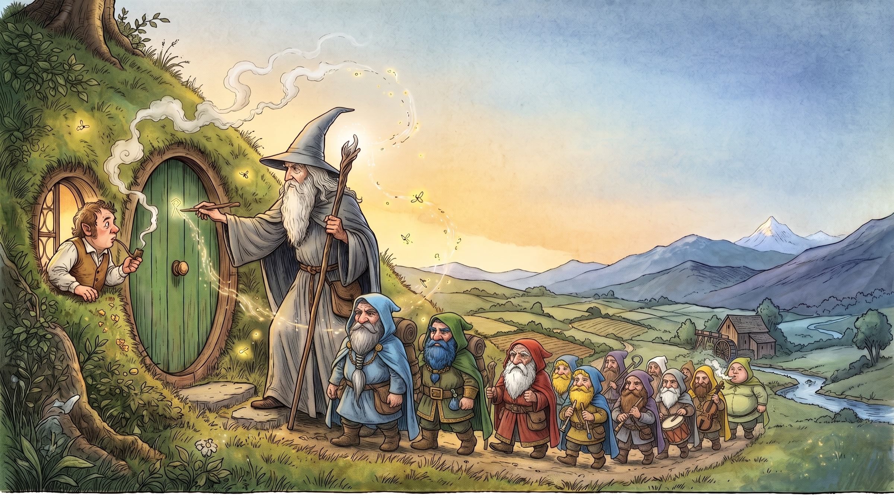
Be Gandalf
[ ONE LAST THING ]
BILBO
Wanted his armchair. Gandalf saw the Took in him: a buried hunger for adventure.
THORIN & CO.
Wanted their mountain back. Gandalf gave the quest a plan, and a burglar.
ARAGORN
Wanted the crown, and Arwen. Gandalf stood by who he really was.
FRODO
Wanted to save the Shire. Gandalf showed him why it had to be him.
Meet each recruit’s real motive — and know them better than they know themselves.
Copyright Dobromir Montauk, 2026
[ 34 ]
Notes:
Be Gandalf: the best recruiter in fiction. Bilbo wanted his comfort; Gandalf knew he had a Took's taste for adventure and signed him up before he could refuse (The Hobbit, ch. 1: the mark on the door, the Dwarves arriving). Thorin's company wanted their treasure and homeland back; Gandalf backed them, while his real goal was removing Smaug as a threat (Unfinished Tales, 'The Quest of Erebor'). Aragorn was the heir of Isildur living as a Ranger; Gandalf was his long-time friend and ally. Frodo volunteered at the Council of Elrond, 'I will take the Ring, though I do not know the way.' Real motives. Bilbo: his Tookish side; the dwarves' song woke a longing to see the mountains and wear a sword instead of a walking-stick, and Gloin's jab that he looked more like a grocer than a burglar stung his pride into saying yes. Gandalf had told the dwarves there was more in Bilbo than he had any idea of himself. Aragorn: to claim the crown of Gondor and Arnor, the condition Elrond set for marrying Arwen (Appendix A); Gandalf was his long-time ally and vouched for him in his letter at Bree. Frodo: love of the Shire; he said he wanted to save it. Note: in The Lord of the Rings, Elrond formally chose the Nine; Gandalf's recruiting shows most in The Hobbit.

